Slide 1
IMSE/CIS 381 Industrial Robotics
LAB 2
Position Registers and Programs
Lab Instructor: Gabriele Galli
Email: ggalli@umich.edu

Slide 2
RECAP OF LAST WEEK
Most common types of frames:
World frame.
Tool frame.
User frame.

Slide 3
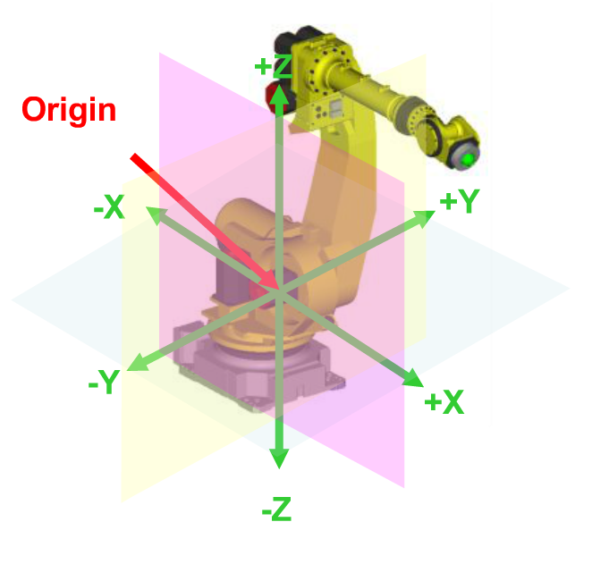
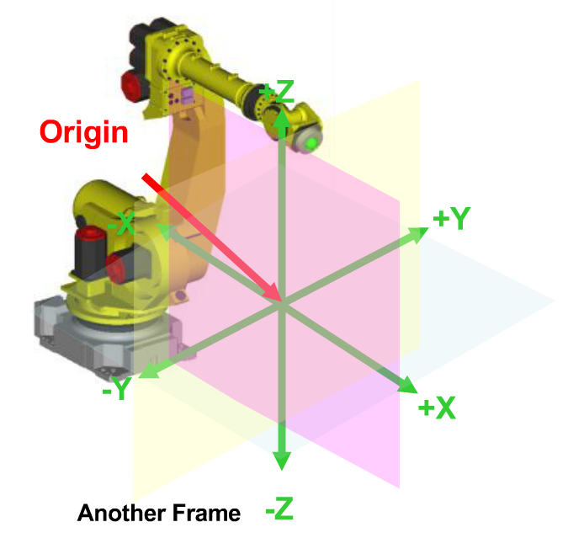
What is a frame?
World frame
User frame

Slide 4
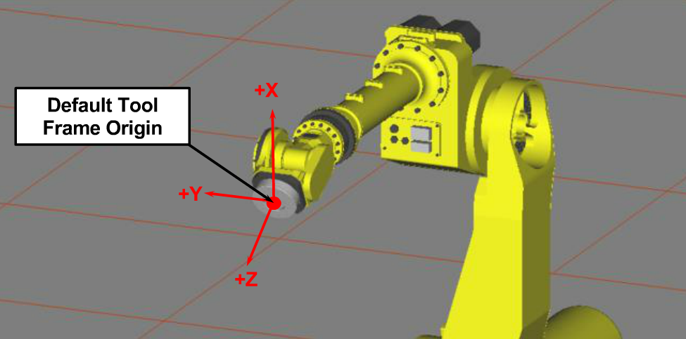
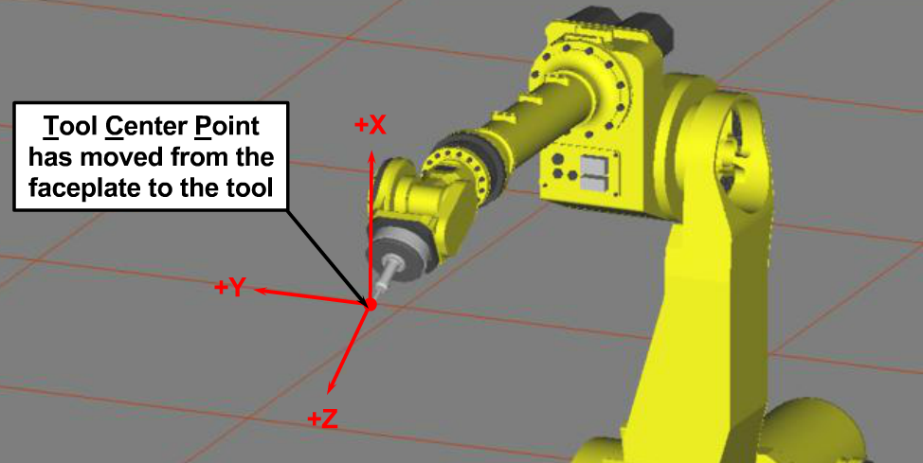
What is a frame?
Default Tool frame
User defined Tool frame

Slide 5
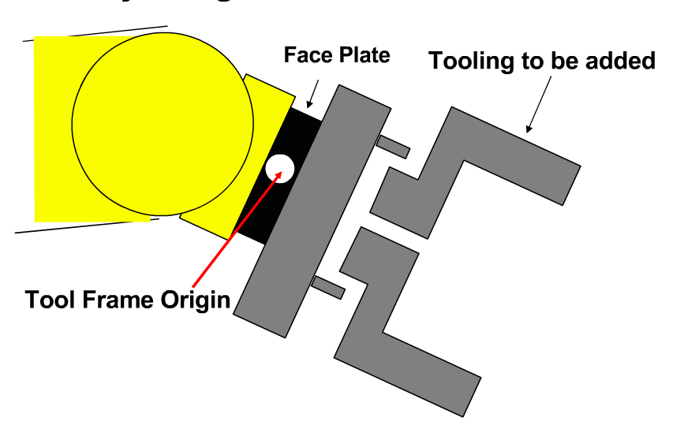
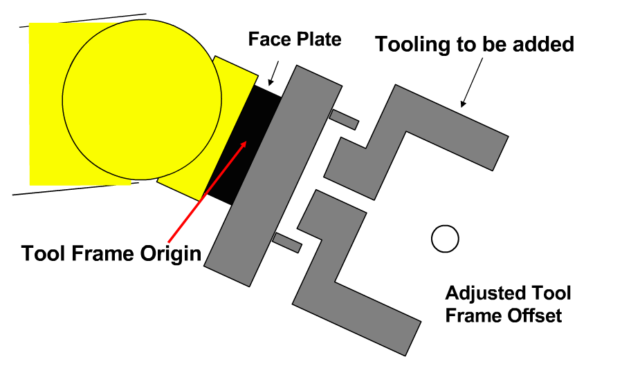
What is a frame?

Slide 6
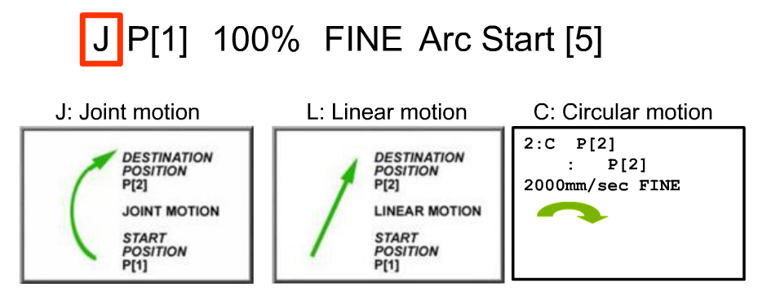
Motion Types

Slide 7
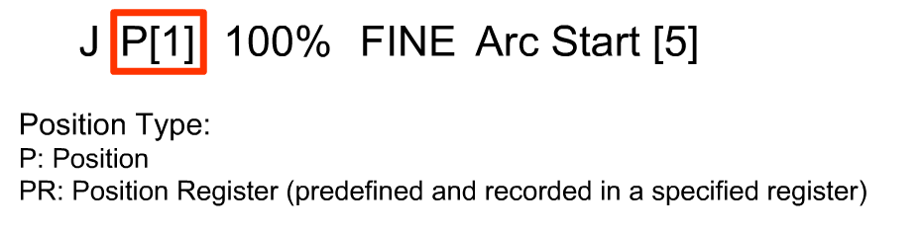
Motion Types

Slide 8
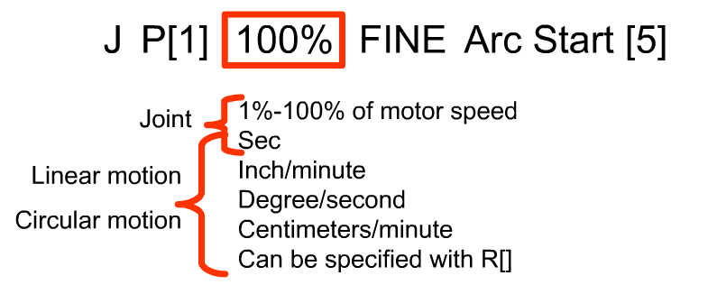
Motion Types

Slide 9
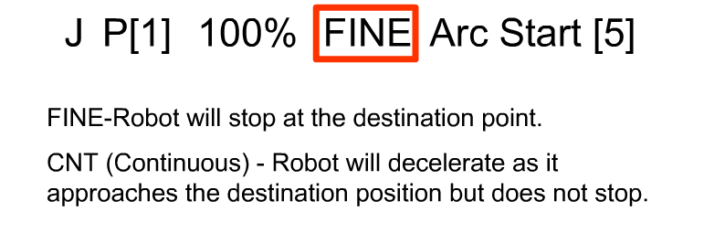
Motion Types

Slide 10
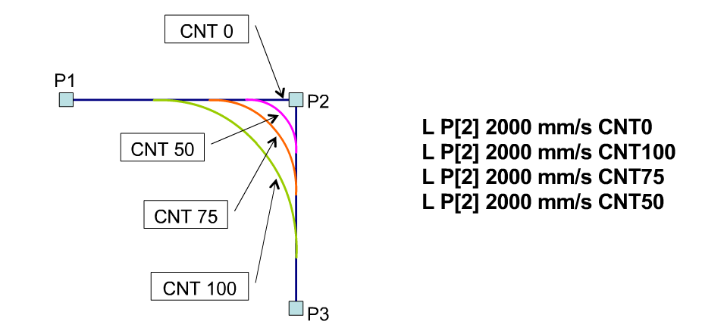
Motion Types

Slide 11
OBJECTIVES
The main objective of this experiment is to operate Fanuc robots and implement a script through the teach pendant.
Learn and implement basic concepts of position registers in positions and paths. Execute a program from the Standard Operators Panel.

Slide 12
Lab Tasks
Create a Position Register.
Create a Shape Program.

Slide 13
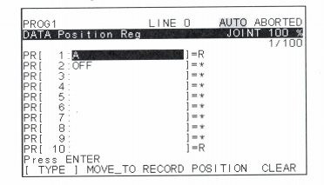
Task 1: Create a Position Register
Position registers basically save the position of the robot at a given x, y and z in order to be used later.
Record a position using PR.
Change the value of a position register.
Name the position register.

Slide 14
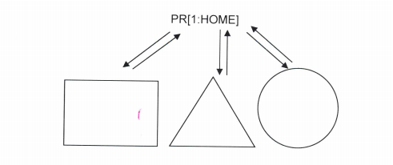
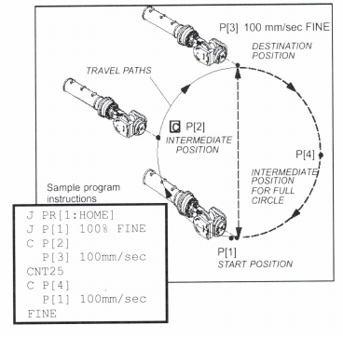
Task 2: Create a Shape program
Create a program called: IMSE381Shapes
Define a User frame or use world frame.
Follow the traces and record points for all shapes.

Slide 15
Report Structure
Cover Page
Abstract
Table of content
Introduction
Objective
Background
Apparatus
Methodology
Lab 1
Summary of the procedures.
Comment on the program in the first part.
User frame and tool frame.
Lab 2
Summary of the procedures.
Your group’s shape program.
Pictures of the drawn shapes.
Discussion (what you learnt in your own words)
References

Slide 16
Any Questions?

